Slide 1
SOPs and Documenting Projects in REDCap
There is existing regulation in the industry to have in place and follow Standard Operating Procedures to conduct Clinical Trials
It’s important to document the development of each project supported in REDCap

Slide 2
SOPs and Documenting Projects in REDCap
To achieve these goals CRSU at Vancouver is working on the definition of its own SOPs, including those related to the Life Cycle of a project
In parallel with the development of each project in REDCap, key steps on it are documented in a non-research project, “Life Cycle” project

Slide 3
SOPs and Documenting Projects in REDCap
The different phases considered in the development of a project are aligned with REDCap:
Initiation
Development
Production
Conclusion
Archival

Slide 4
SOPs and Documenting Projects in REDCap
The major actions regulated and documented are:
  Request a new project
  Project definition
  Letter of collaboration and agreement
  Validation testing
  User account request
  Training log
  Change Project definition
  Platform transfer specifications
  Data sharing
  Database closure
  Decommissioning

Slide 5
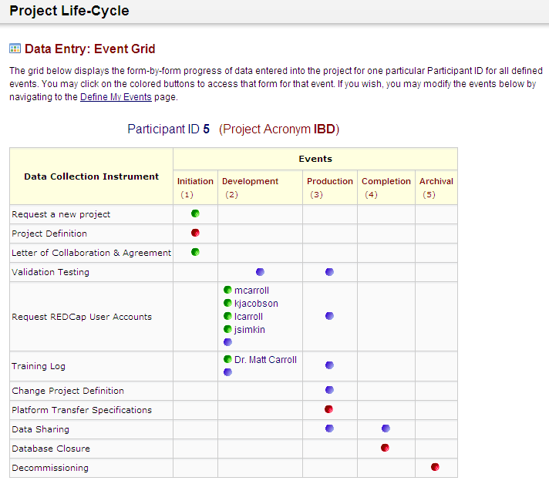
The design of the project is as follows:
Phases
Actions

Slide 6
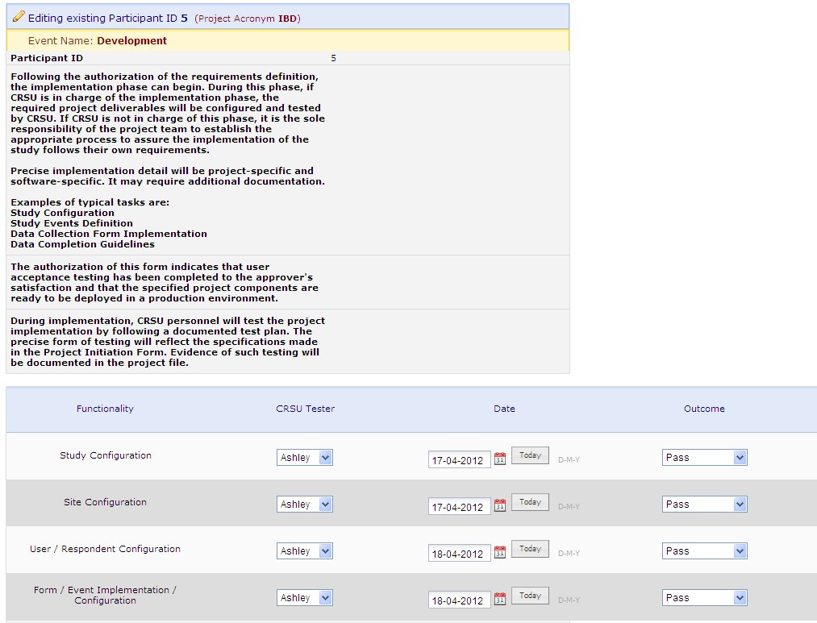
Instructions
Documentation

Slide 7
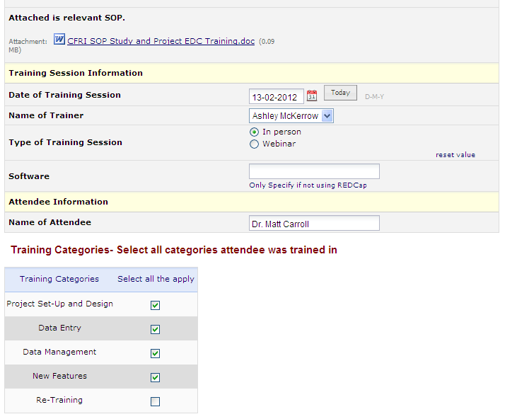
SOP
Documenting
Training

Slide 8
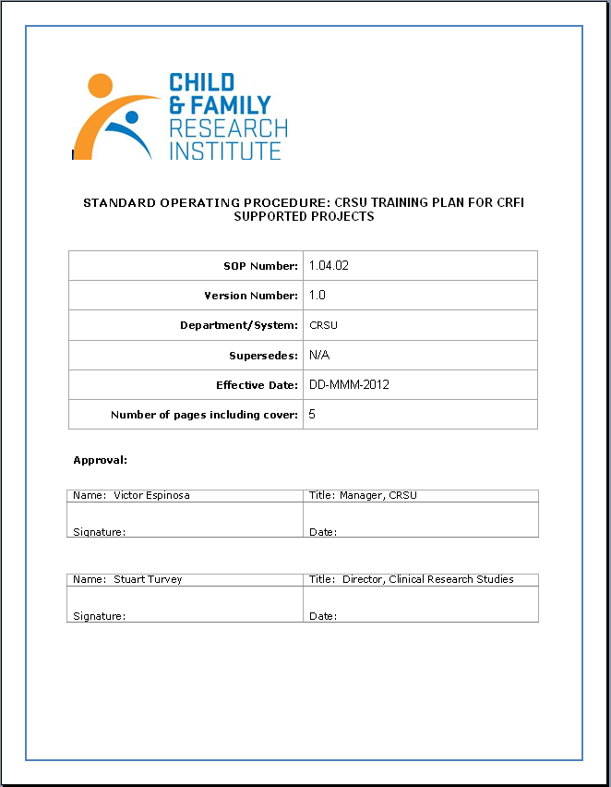
SOPs
Version
control

Slide 9
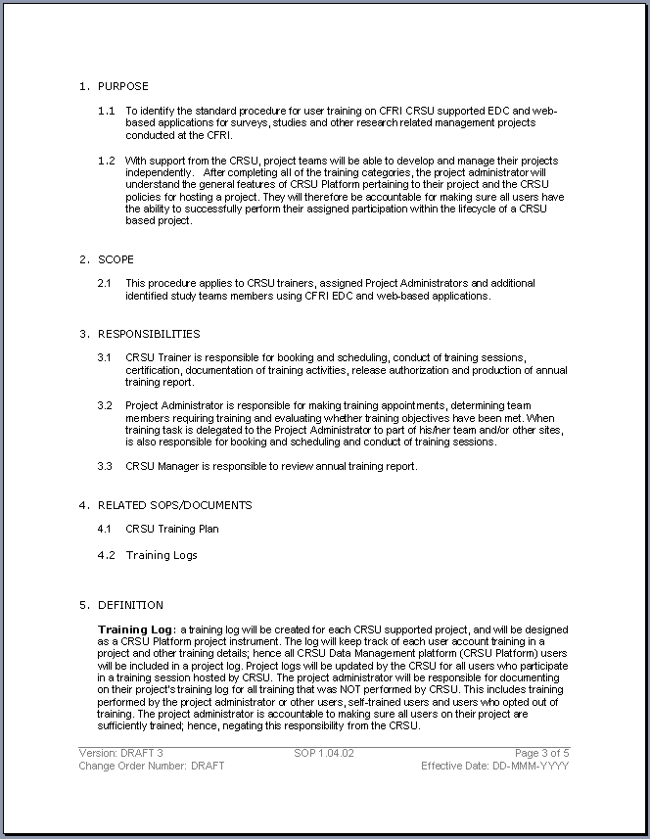
SOPs
Purpose
Scope
Responsibilities
Definitions

Slide 10
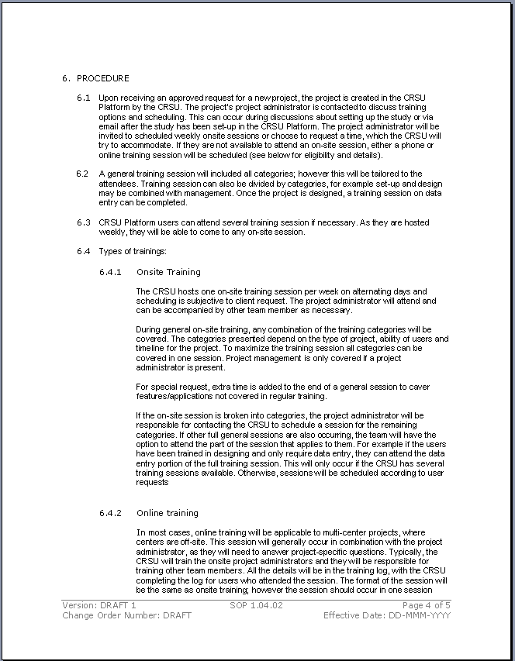
SOPs
Procedure
(types of training)

Slide 11
Thank you!

